Slide 1
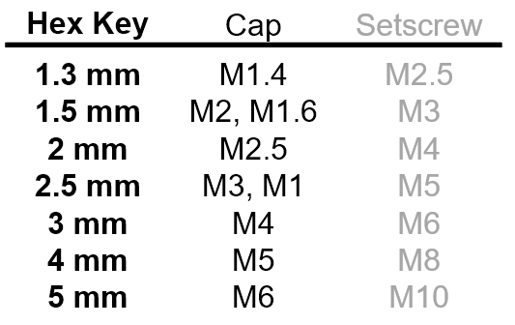
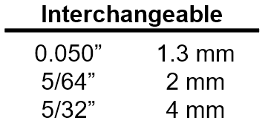
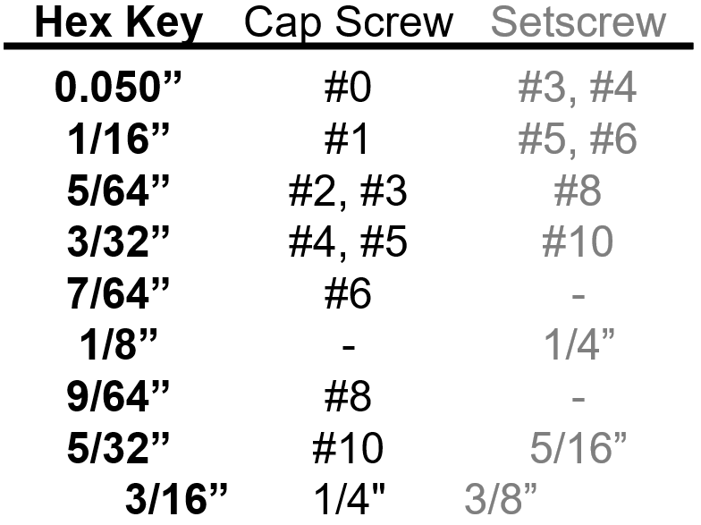
Hex Key Stand Label
https://github.com/tweber225/hex-label
Hex Key | Cap Screw | Setscrew
0.050” | #0 | #3, #4
1/16” | #1 | #5, #6
5/64” | #2, #3 | #8
3/32” | #4, #5 | #10
7/64” | #6 | -
1/8” | - | 1/4”
9/64” | #8 | -
5/32” | #10 | 5/16”
3/16” | 1/4" | 3/8”
Hex Key | Cap Screw | Setscrew
1.3 mm | M1.4 | M2.5
1.5 mm | M2, M1.6 | M3
2 mm | M2.5 | M4
2.5 mm | M3, M1 | M5
3 mm | M4 | M6
4 mm | M5 | M8
5 mm | M6 | M10
Interchangeable
0.050” | 1.3 mm
5/64” | 2 mm
5/32” | 4 mm
--CUT--
Hex Key | Cap Screw | Setscrew
0.050” | #0 | #3, #4
1/16” | #1 | #5, #6
5/64” | #2, #3 | #8
3/32” | #4, #5 | #10
7/64” | #6 | -
1/8” | - | 1/4”
9/64” | #8 | -
5/32” | #10 | 5/16”
3/16” | 1/4" | 3/8”
Hex Key | Cap Screw | Setscrew
1.3 mm | M1.4 | M2.5
1.5 mm | M2, M1.6 | M3
2 mm | M2.5 | M4
2.5 mm | M3, M1 | M5
3 mm | M4 | M6
4 mm | M5 | M8
5 mm | M6 | M10
Interchangeable
0.050” | 1.3 mm
5/64” | 2 mm
5/32” | 4 mm
--CUT--

